Slide 1
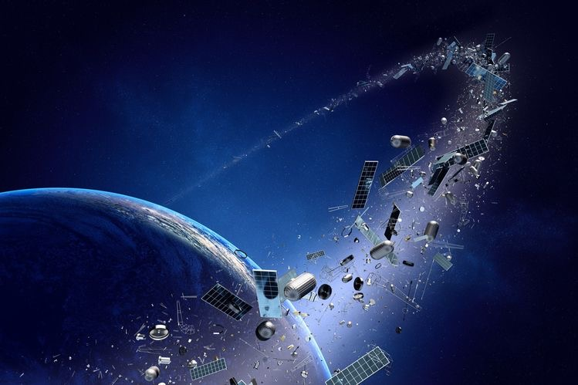
Space orbit prediction
By
Albraa khayat
Linah ali abohajar
Mohammed Abdulbari
Amr Rubain

Slide 2
Introduction
Why are satellites in "blue" orbit important to Earth observation?
It constantly monitors the Earth and sends data to ground stations. They help monitor the environment and changes on the Earth's surface, and their applications cover everything from urban planning to plant monitoring, etc. depending on resolution.

Slide 3
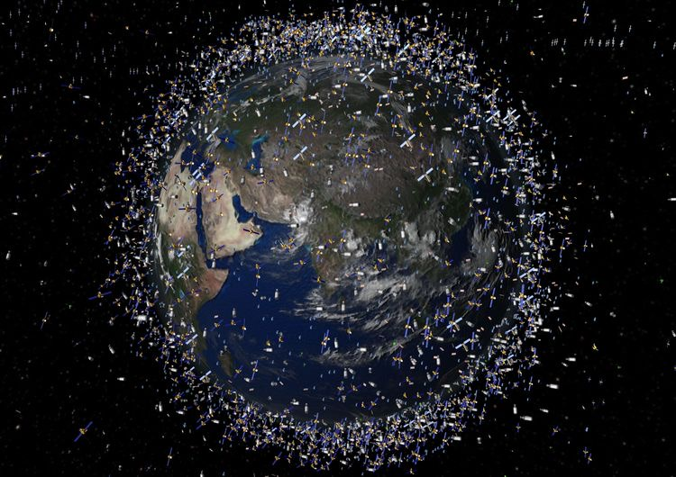
How satellites look around earth

Slide 4
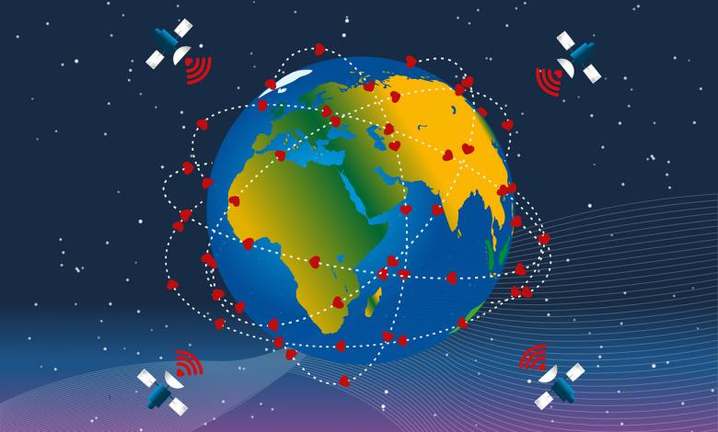
Satellite orbits
Most satellites orbit around the Earth often close to Earth at an altitude of about 500 km. In this orbit, the satellite or the International Space Station completes a revolution every 90 minutes. On the other hand, we need to indicate all orbits in limited time period.

Slide 5
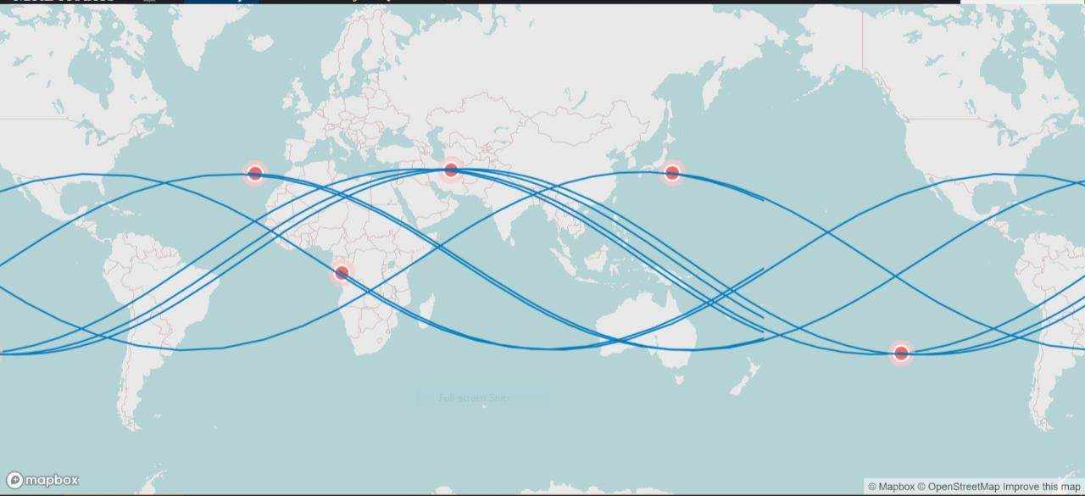
Project Purpose
Collect data from open resources
Prediction of all orbits in short time

Slide 6
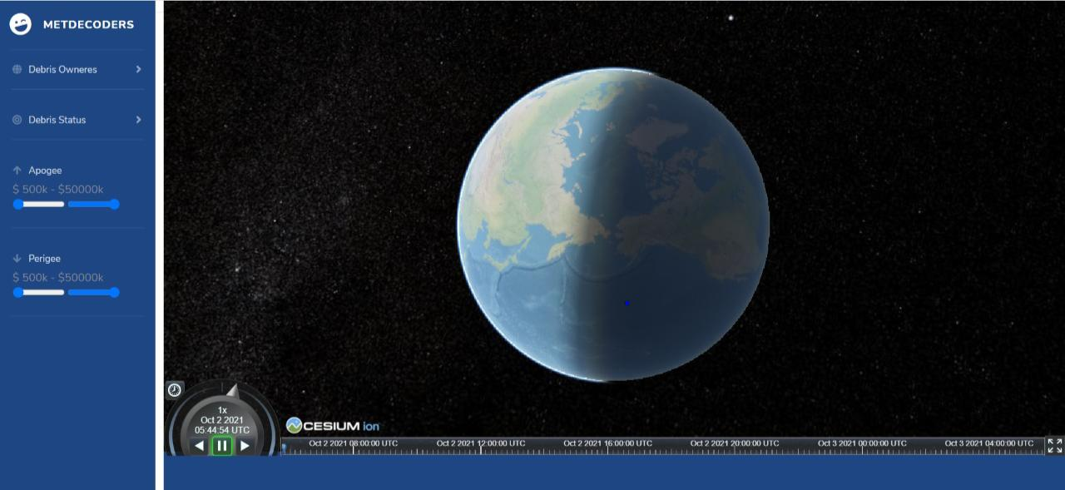
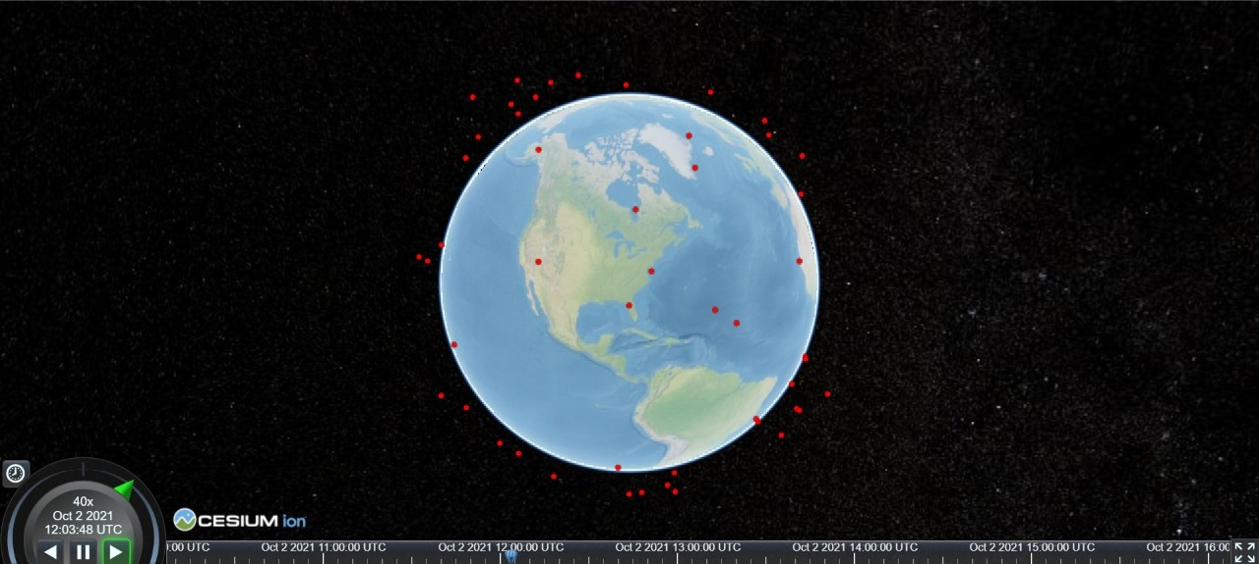
Illustrate output on the visualization map

